Slide 1

Play like DJ with Deep Learning
March 23, 2020
Notes:
Hi, my name is David Park. To briefly introduce myself before the presentation, I’ve been working in consulting industry for past 6 years, focusing on business processes and technology implementation for several global financial institutions and I recently graduated from metis in an effort to marry my consulting experience with more technical knowledge around data science and Machine learning. I am also a DJ and an owner of an underground techno label in New York City. And today, in light of exploring my passion in machine learning space, I will be presenting a DJ mix generator I created using deep learning.

Slide 2
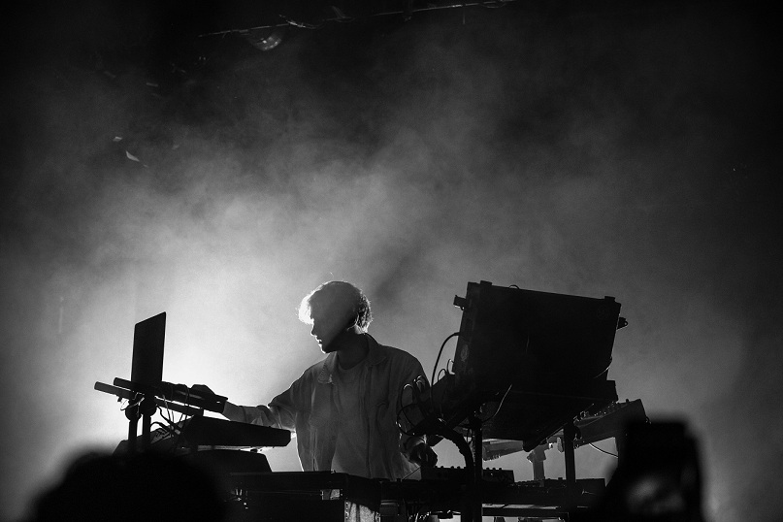
Music App for DJs
Music recommenders in the market only for general listeners
Collaborative filtering
User preference
Content-based filtering
Genres, artists..
Deep Learning
Transition and flow
Content-based filtering
BPM, Key, Energy Level
It’s time to have a cool music app for DJs!
Notes:
So what’s my motivation behind this project? Well, many music recommenders in the market just targets general listeners but there is not a single good music app for DJs.
As a DJ myself, I always wanted to find a music recommender that can help me find and arrange tracks in less time consuming manner.
So I decided to use the final project at Metis to create my own using deep learning and some content-based filtering

Slide 3
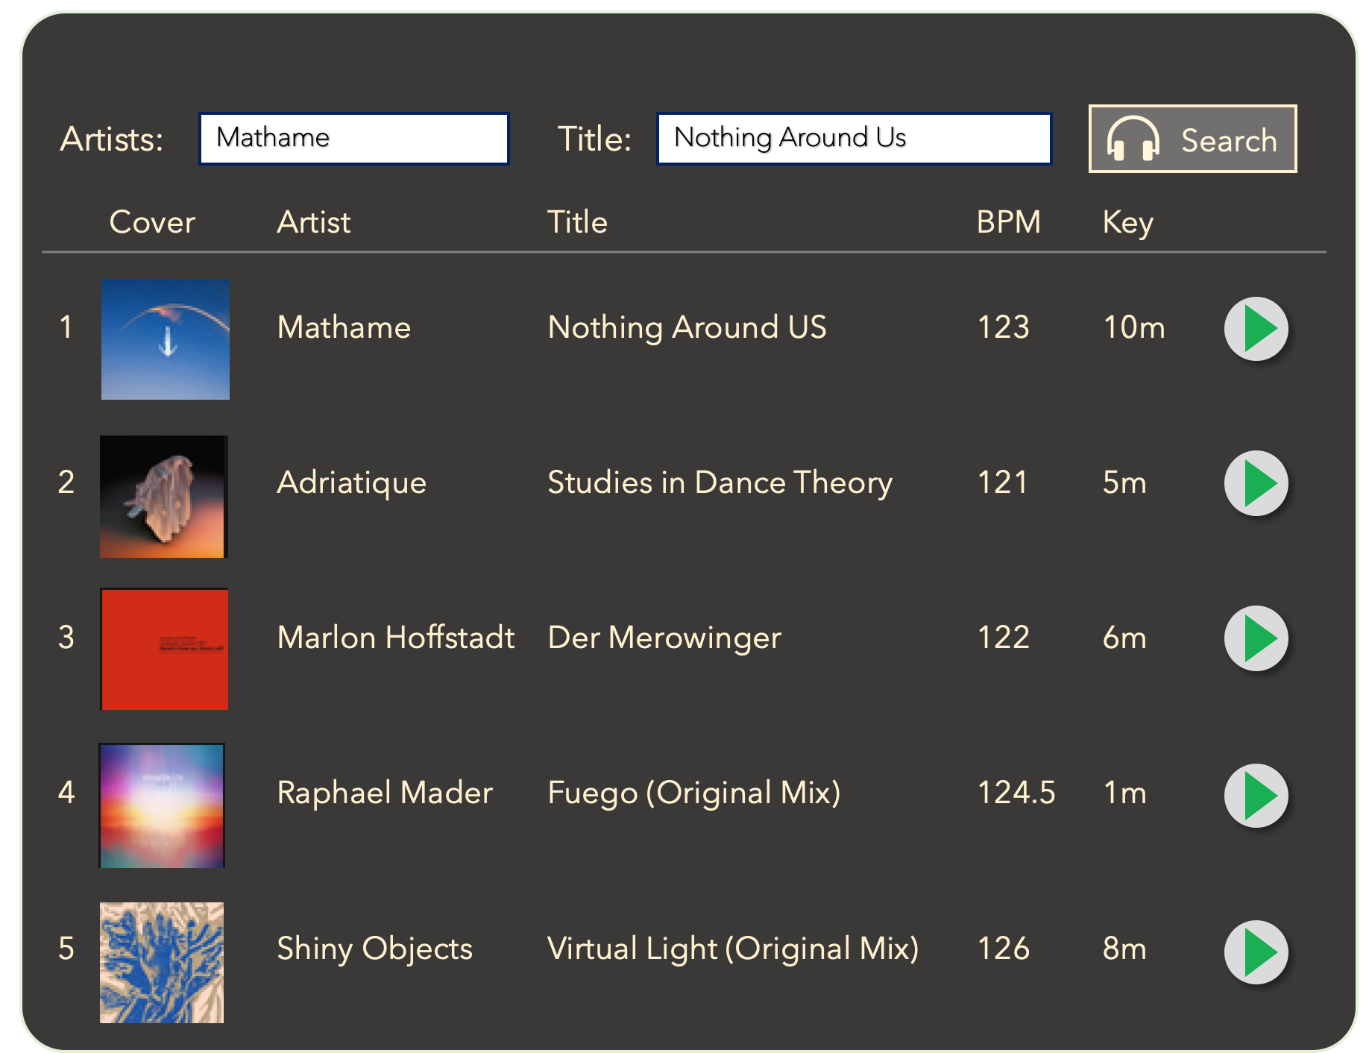

Introducing DJ Koze!
Focus on generating a playlist with
Seamless transition
Natural flow
Great app for
Amateur and pro DJs
Lounge / Bar owners
Anyone who wants their own party!
Notes:
So today, I want to introduce my music app DJ Koze
Koze has a different mission statement than other music recommender. It aims to generate a playlist with seamless transition and natural flow as if they are played by professional DJs,
So who could be the potential users of Koze?
Well, you have all the DJs who wants to save time preparing a tracklist
Lounge/Bar owners seeking good music without having DJs every night
And really anyone who wants to throw a party and have a good time!

Slide 4
How Mixing Works
Texture of Music
Frequency
Amplitude
Energy Level
Track A
Track B
Harmonic Mixing
BPM
Key
Mode
Notes:
Before I dive in, I want to quickly introduce how mixing works which is the fundamentals behind my model.
First of all, two tracks should have similar textures to go well together, which are mainly defined by frequency, amplitude, and energy level
Secondly, mix-in and mix-out part should share similarity in key, mode, and tempo to achieve the harmonic mixing

Slide 5
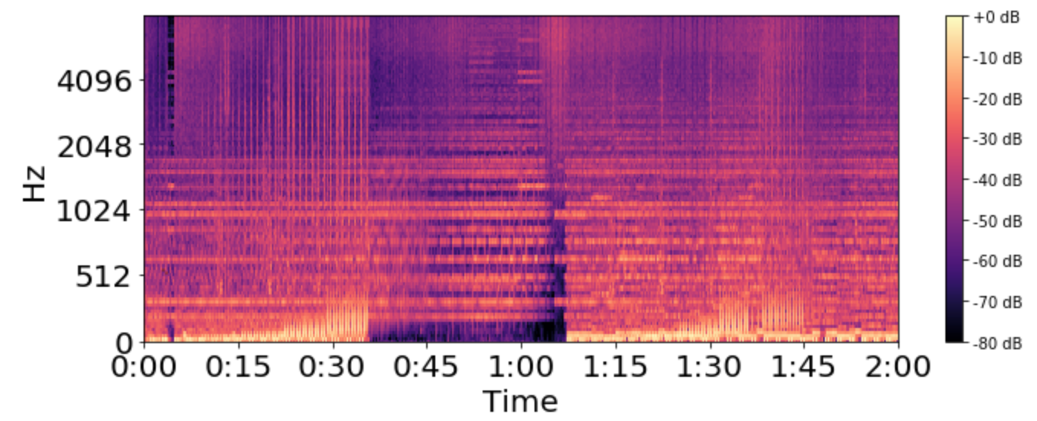
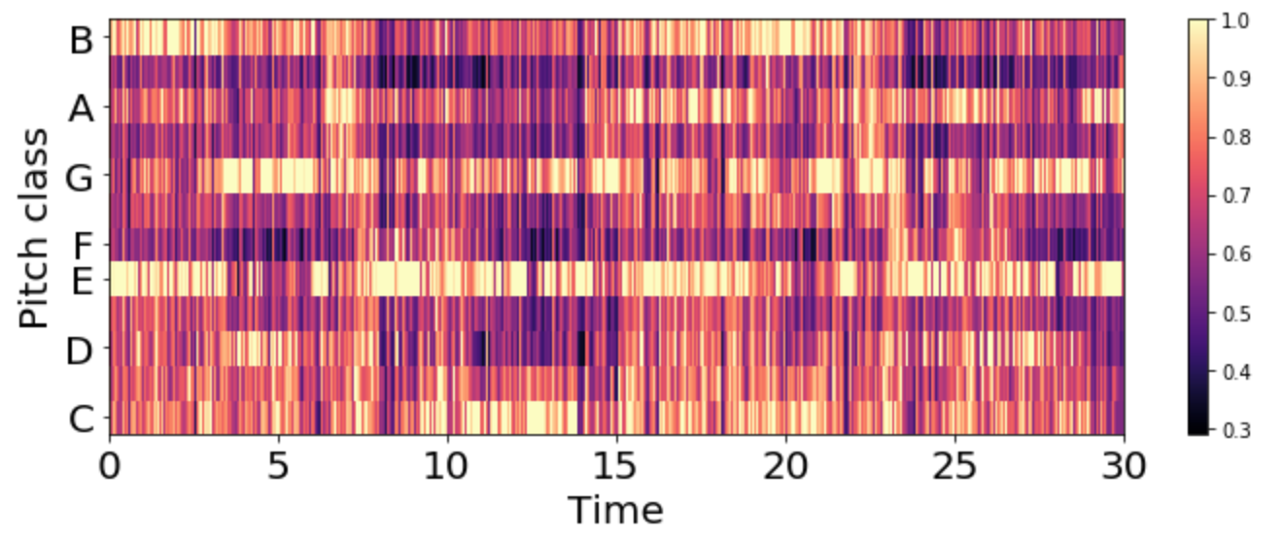
How Mixing Works
Texture of Music
Frequency
Amplitude
Energy Level
Track A
Spectrogram
Track B
Harmonic Mixing
BPM
Key
Mode
Chromagram
Notes:
And there are some cool image representation of these.
based on my research, spectrogram is an image representation of frequency and amplitude that best captures the texture of the music.
As you can see from top right, x axis is time span y axis is the range of frequencies and strength/loudness of the respective frequency levels are described by the brightness. Brighter the color, higher amplitude or stronger presence in the respective frequency level.
and chromagram on the bottom left captures various level of pitches over time also described by the brightness of the color. And this can help the harmonic mixing btw two tracks

Slide 6



Data Processing & Modeling
~ 3000 mp3 files downloaded
(all electronic music)
Audio features obtained through Spotify API
Notes:
To build my model, I used over 2000 mp3 files downloaded from online music stores used by prof DJs, then I collected audio features such as tempo and key through spotify API.

Slide 7
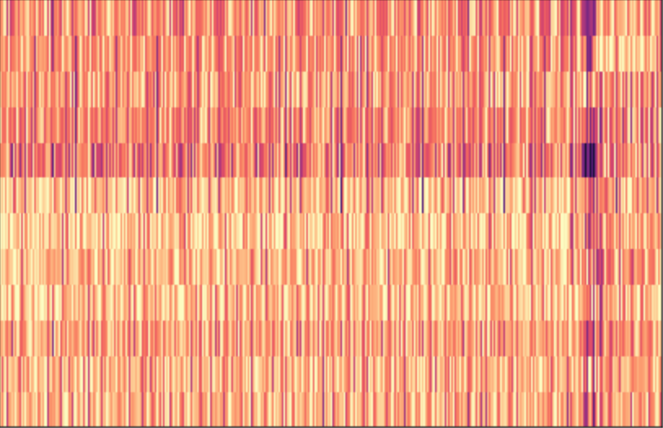
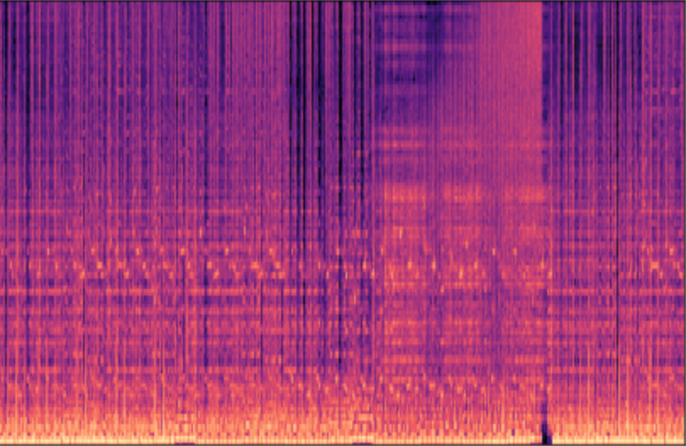

Data Processing & Modeling
~ 3000 mp3 files downloaded
(all electronic music)
Convert mp3 to images representation
Intro / Ending:
Chromagram
Middle:
Spectrogram
Audio features obtained through Spotify API
Notes:
Next, I converted mp3 files into image representations. I used chromagram for intro and ending section of the tracks to achieve harmonic mixing and used spectrogram in the middle part of the tracks to capture overall vibe and texture of the music.

Slide 8

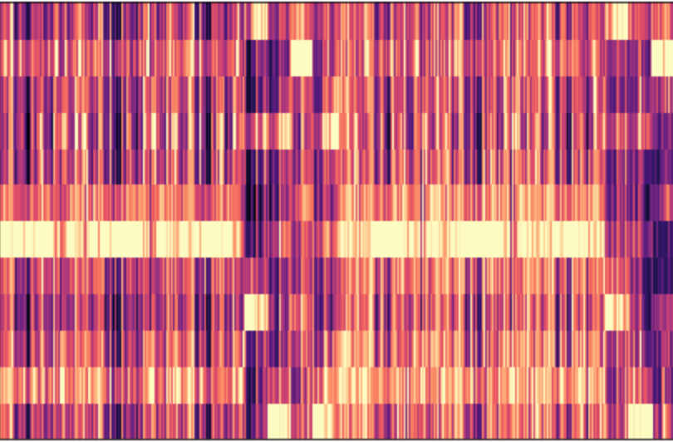
Data Processing & Modeling
~ 3000 mp3 files downloaded
(all electronic music)
Convert mp3 to images representation
Intro / Ending:
Chromagram
Middle:
Spectrogram
Feature Extraction:
Using Convolutional Neural Net and PCA
VGG16 Transfer Learning
432x288x3
54x36x256
Audio features obtained through Spotify API
216x144x64
PCA
108x72x128
27x18x512
13x9x512
59904x1
500x1
Notes:
Then I used pretrained neural network, VGG16, to extract feature vectors of these images and further reduced dimensionality by running Principal Component Analysis. And all data storage and computation was done within google cloud platform.

Slide 9



Recommendation Logic
Filter 1
Compatibility
Filter 2
Musical Texture
Filter 3
Mashability
BPM +/- 2.5
Energy Level +/-15%
Harmonic Key/Mode
Cosine similarity on spectrogram feature vectors
Cosine similarity on chromagram feature vectors
Track 1
Track 2
Filter 1
Mathame -
Nothing Around Us
Bicep - Aura
Next track
Top 30 tracks
100+ tracks
Notes:
Finally, this slide shows how my recommendation system works.
First it uses content-based filtering to identify candidate tracks with neighboring audio features. With my domain knowledge, I was able to define acceptable range for selected audio features, which are BPM, energy level, and key/mode
Then, using cosine similarity on spectrograms and chromagrams feature vectors, the model will find the closest track in terms of musical texture and mashability.
Subsequently, the suggested track becomes a new input to generate the next track and this will enable some variation to the flow and makes the mix more interesting and creative

Slide 10


Model Results
125
Bicep
Aura
123
1d
Petar Dundov
Pyroelectric
123
1d
DJ Zombi
Breakfast Of Champion
123
8d
Pitto, Noir
You (Noir Remix)
122.5
1d
Melodic Techno or Progressive recommended
BPM and Key in mixable range
Notes:
In this slide, I want to show my model result using the input track named Nothing Around Us by the artist named Mathame. And the overall output was pretty encouraging. It selected all the tracks with BPM and keys in mixable ranges. Also, it finds those tracks that share similar sub-genres, in this case, they were Melodic Techno and Progressive house.

Slide 11
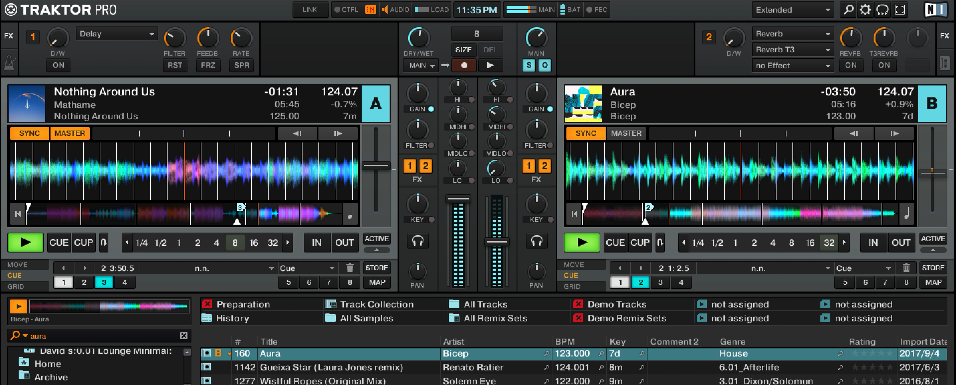
How Effective is DJ Koze?
Notes:
Let’s see how effective DJ Koze is! To show that, I want to share this clip where I mixed the first two tracks suggested by DJ Koze
Right now track A on the left is playing in full volume. And take a look at the volume faders in the middle. I’m slowing bringing in track B to the mix.
`
Now you can hear track B pretty clearly
Alright Track A is completely off and it’s fully transitioned to track B
So as you can see from my demo, I thought DJ Koze did rather impressive job. So overall I was pretty happy with the outcome and with some more refinement I might actually be able to use DJ Koze myself for my future gigs! And hopefully, other people can also see this app very entertaining and helpful!

Slide 12
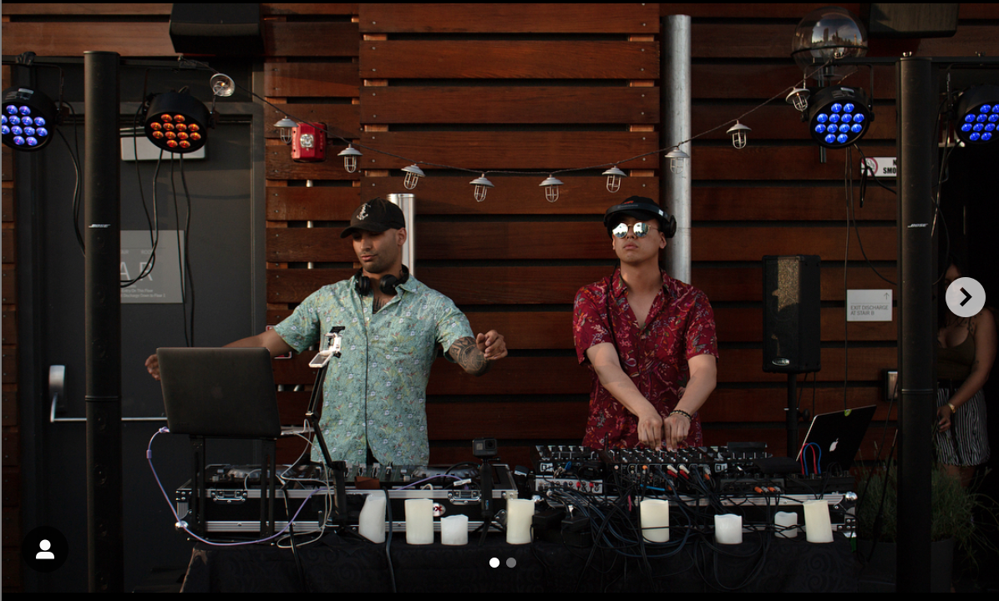

Thank you!
e-mail: dcpjungwoo@gmail.com
Linkedin: /in/dcpjungwoo
Github: dcpjungwoo

